Slide 1

Road Safety
By:
Parastoo Razavi
Cyrus Au Being
John Bingley
Seranica Williamson

Slide 2
EXECUTIVE SUMMARY
Decreasing the risk of accident on the road and improving the quality of roads is one of the signs of progress in a country.
Based on WHO report on 2018, Deaths from road traffic crashes have increased to 1.35 million a year which is 8th leading cause of death for people of all ages and number one cause of death for children and young adults 5-29 years of age. Millions of people are injured or disabled every year. The meaning of this data is the cost of emergency response, health care and government support increase as well. So, we can understand the importance of road safety.

Slide 3
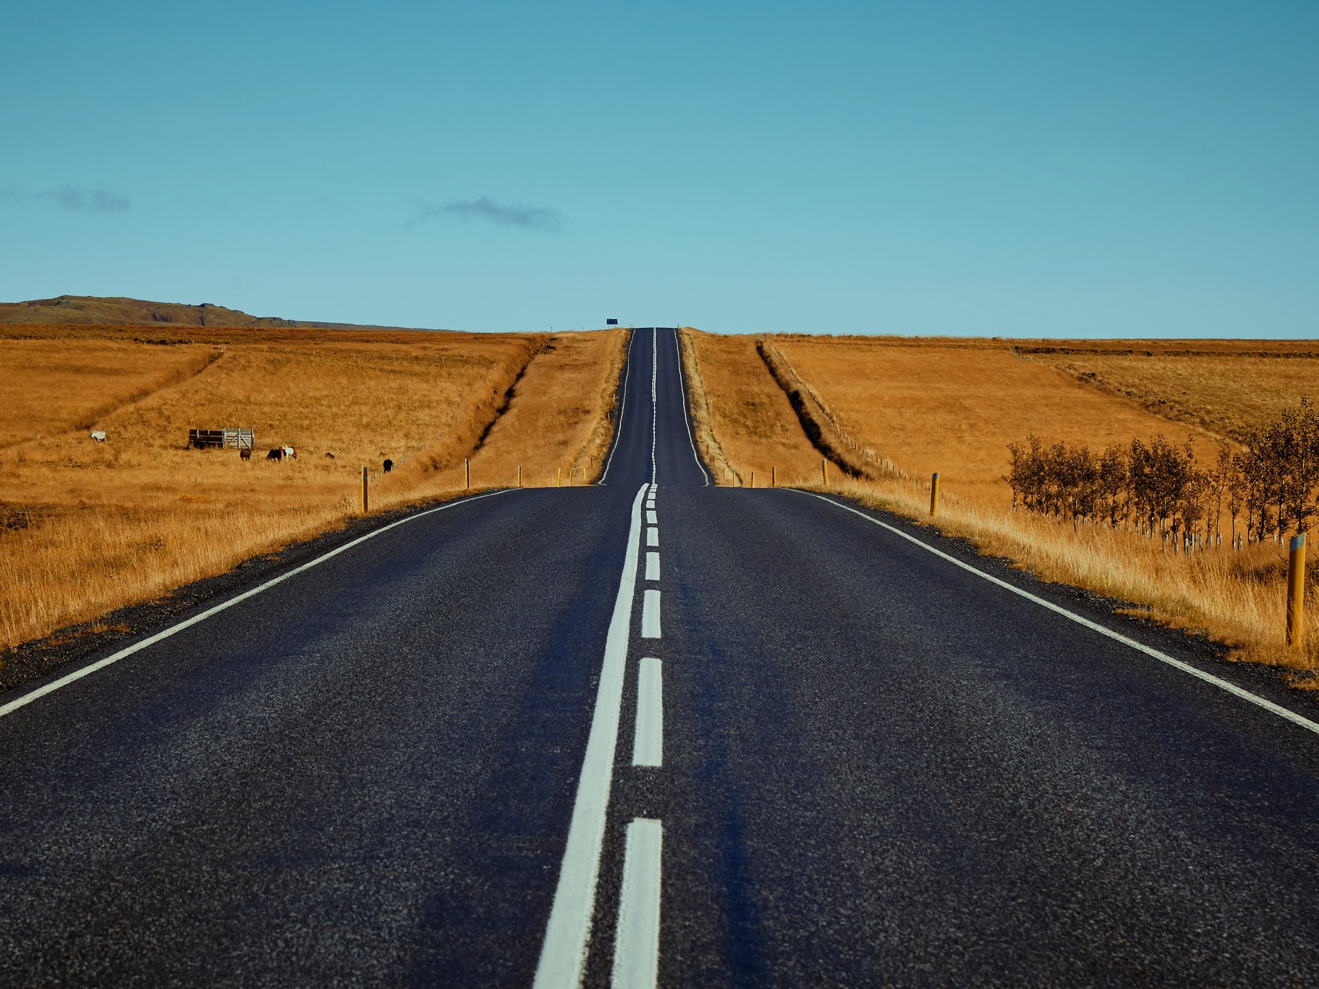
1.35 million
people
die each year as a result of road traffic crashes.
_{#1}
cause of death for children and young adults 5-29 years of age
₈th
leading cause of death for people of all ages
88%
of pedestrian
travel occurs on roads that are unsafe.

Slide 4
Questions
Based on the importance of the cause study in this area and by information collected by the group, it was decided to direct the project to answer the following questions:
• Does higher income make you safer on the road?
• Does differences in the types of road users affected on the rates of deaths?
• How many countries reducing distracted driving by banned mobile phone while driving?
• How much mobile phone laws improve safety in roads?
• By knowing that children are very vulnerable, does child restraints laws protect them in accident?
• How much wearing seatbelt reduce the risk of death among drivers?
• How seatbelt can protect other occupants?
• How many countries control death rate by driving by using motorcycle helmet?
• Does drink–driving laws have an effect on road safety?
• Countries try to increase their road safety by managing speed, which speed limits were successful?

Slide 5

Data
The data is collected from following websites:
• https://www.who.int/data/gho
• https://stats.oecd.org/
• "Road injury accidents : Road casualties (under Transport > Transport Safety > Road Injury Accidents"
• "Road injury accidents : Passenger Transport Showing the Passenger KM, millions (under Transport > Transport Measurement > Passenger Tranpsort > Overview> Select ""Road Passenger Transport"" on the header ""Variable"""
• https://apps.who.int/gho/data/node.main.A989?lang=en
• WHO global road safety datasets

Slide 6
Data Cleanup & Exploration
The problem we encountered at this stage:
• Lots of missing data (mostly the countries with low income).
• Information collected at different times.
• Unknown symbols.
By given a lot of effort we couldn't get the incomplete information, it was decided that focus on countries with full information.
We decided to work the recent year in datasets however the year was mismatch.
For some unknown symbols we used “Notepad” to correct data and then import in Panda and correct the rest in Jupiter notebook.

Slide 7
Data Analysis
This analysis could have been more comprehensive if we had full information of all countries.

Slide 8
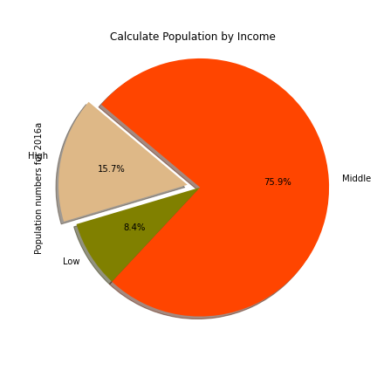
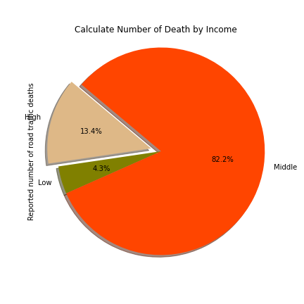
Proportion of population and road traffic deaths by countries income
* Income levels are based on 2017 WORLD BANK classifiers.

Slide 9
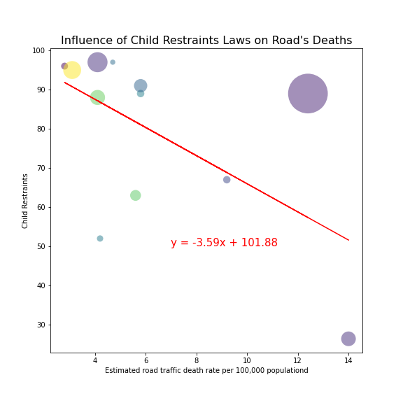
Influence of child restraints laws on road traffic deaths
Child restraints are highly effective in reducing injury and death to chid occupants.
In this scatter plot, x axis is rate of road traffic per 100000 people, y axis is child restraints and the size of each circles representative population.
What is clear on this chart, there is a negative relationship between using child restraints laws and the number of road traffic deaths. In other words, as the usage of child restraints laws goes up, the number of deaths on the road will decrease.
By calculating the r-squared which is 0.34, we can see there is a weak correlation between these items.

Slide 10
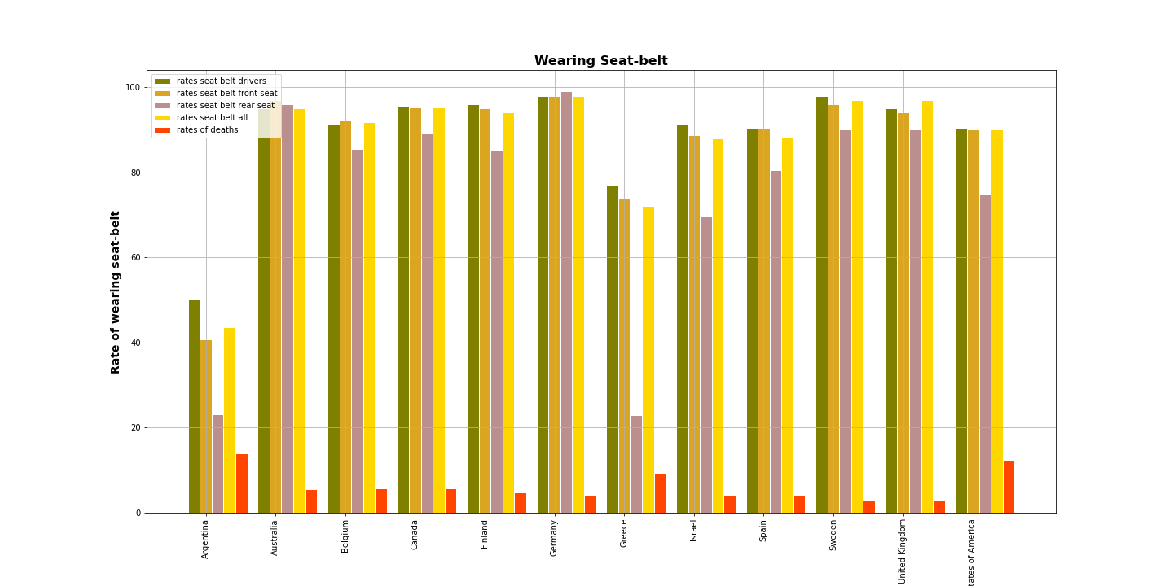
Seat-belt laws
105 countries of 175 countries currently have laws on seat-belt use.
This chart presents the rates of wearing seat-belt for drivers, front seat occupants, rear seats occupants, all occupants and rate on deaths on traffic road.
We could better investigate this if we had the similar data for before enforcement of this law in each county.

Slide 19
In your opinion, what changes should be made to the traffic structure to reduce the number of deaths in this area?

Slide 20
References
https://www.optalert.com/the-evolution-of-road-safety/
https://commons.wikimedia.org/wiki/File:World_Health_Organization_Logo.svg
https://knowinjury.org.au/2016/12/funding-for-road-trauma-data-another-step-towards-safer-australian-roads/
https://www.who.int/violence_injury_prevention/road_safety_status/2018/en/

